Slide 1

COS 214 Project
sudo-apt-get-marks

Slide 2
sudo-apt-get-marks members
u22497082 - Ethan Vletter
u22652974 - Carinda Smith
u23632730 - Janri du Toit
u23577674 - Ethan Wilke
u23656175 - James Neale
u23708833 - Megan Pretorius
u23590883 - Marco Paximadis

Slide 3
Introduction

Slide 4
Final class diagram

Slide 5

City Management:
Create and manage different types of buildings.

Slide 6
Buildings
Add class diagram

Slide 7
Buildings
Explain pattern and attributes and methods

Slide 8

City Management:
Manage Utilities
Powerplants : generate electricity to supply to city.
Functional and Non-functional
Water Supply : ensure steady distribution of water.
Functional and Non-functional
Waste Management : handle waste removal and recycling.
Functional and Non-functional

Slide 9
Utilities
Add class diagram

Slide 10
Utilities
Explain pattern , attributes and methods

Slide 11
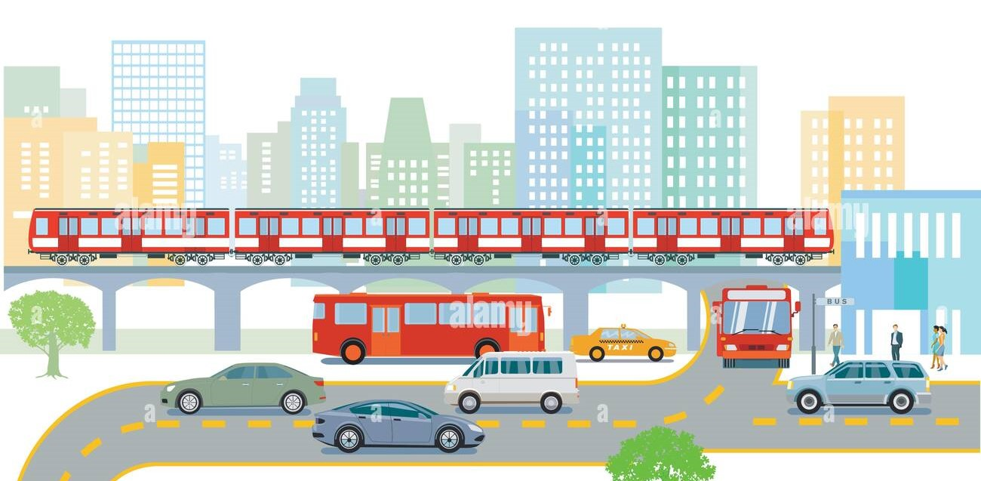
City Management:
Handle Transportation system.
Roads: Basic infrastructure for public transport movement.
Public Transit: Buses to transport citizens to and from place of employment.
Commercial busses transport Commercial Workers to/from
Residence: House to/from Workplace: shop/mall/office on a Commercial road
Government busses transport Government Workers to/from Residence: Mansion to/from Workplace: school/hospital/government on a Government road
Industrial busses transport Industrial Workers to/from Residence: Apartment to/from Workplace: warehouse/plant/factory on an Industrial road
Trains: Transport materials on railways

Slide 12
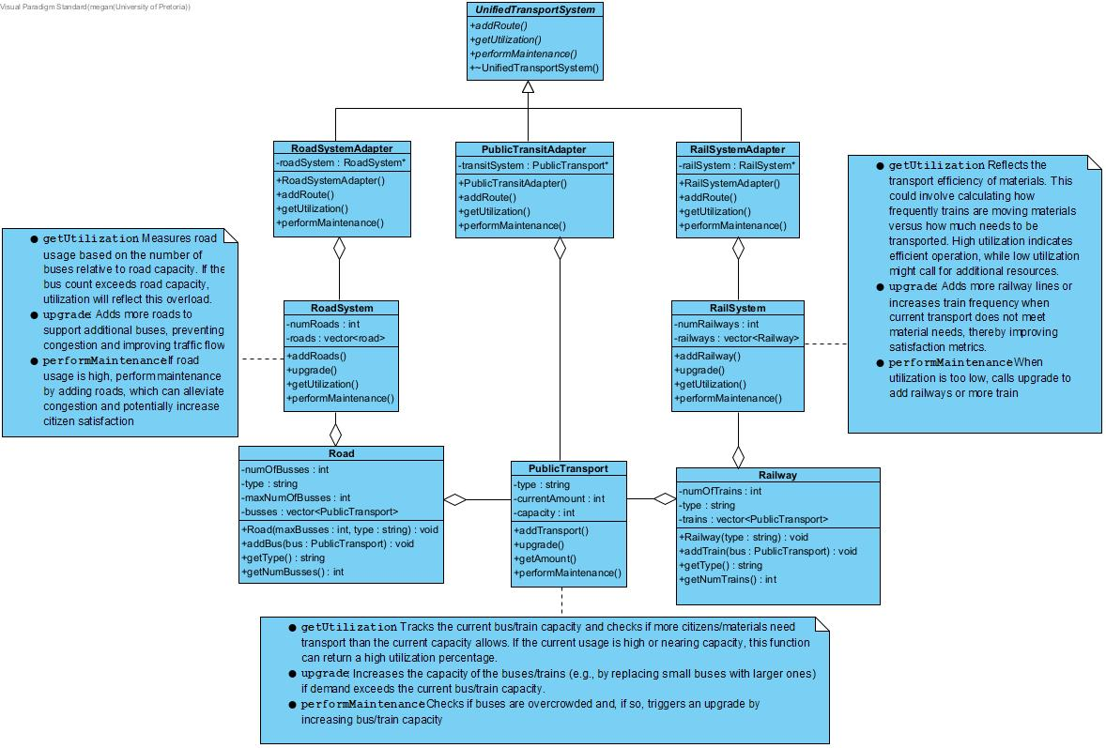
Transportation

Slide 13
Transportation
Explain pattern and attributes and methods

Slide 14
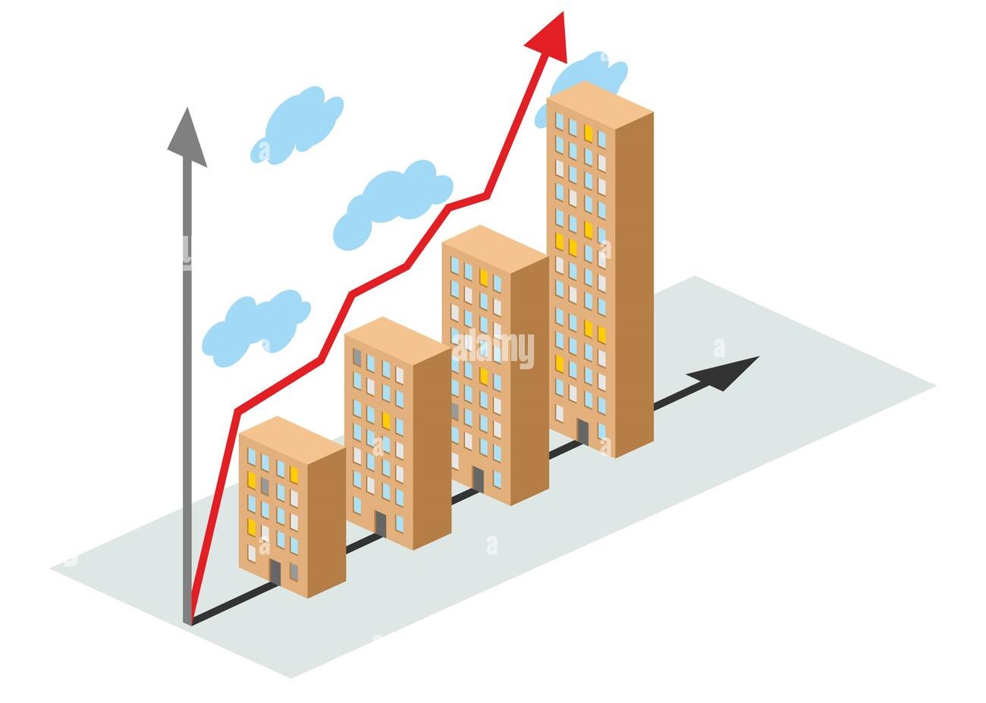
City Management:
City creation and growth

Slide 15
City Management:
Add class diagram

Slide 16
City Management:
Explain pattern , attributes and methods

Slide 17

Resources:
Explain resources

Slide 18
Resources:
Add class diagram

Slide 19
Resources:
Explain pattern , attributes and methods

Slide 20

Taxes
Explain taxes

Slide 21
Taxes
Add class diagram

Slide 22
Taxes
Explain pattern , attributes and methods

Slide 23
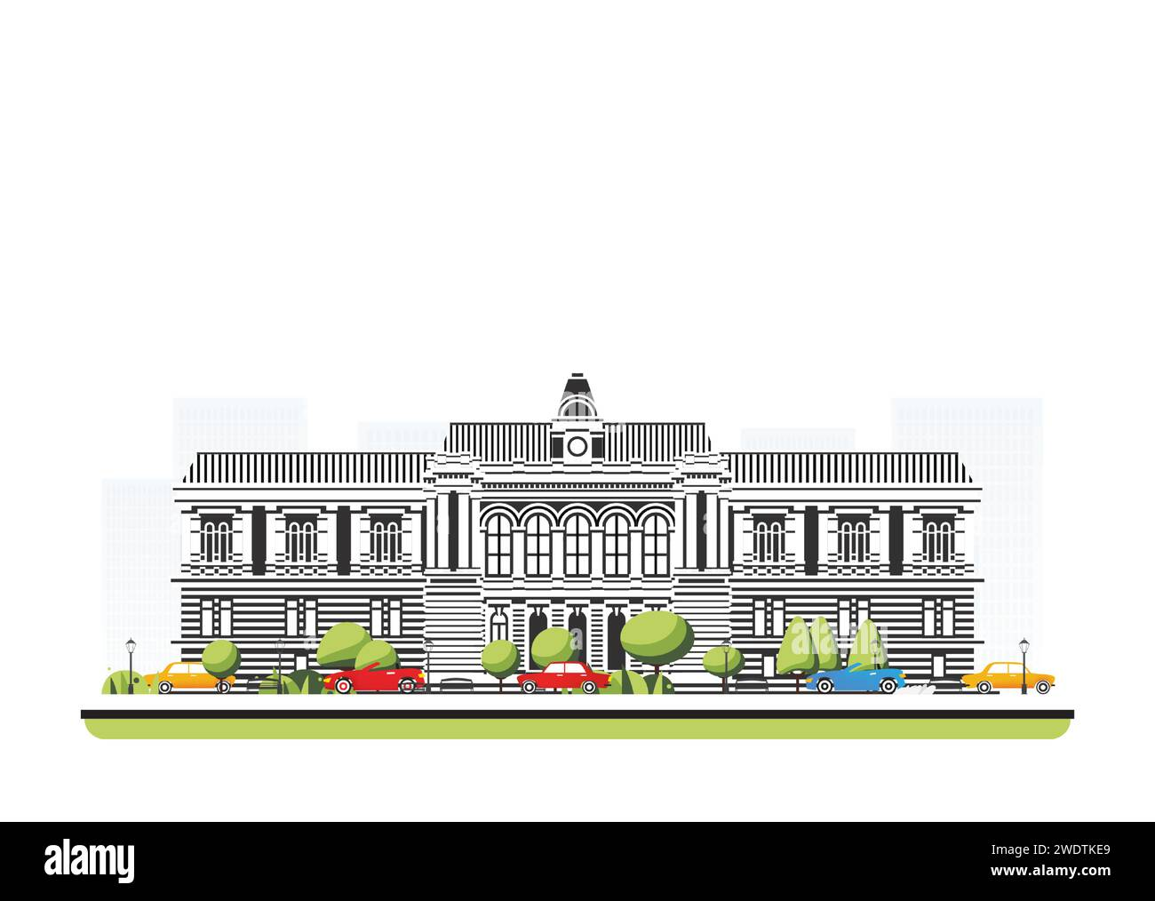
Government
Explain government

Slide 24
Government
Add class diagram

Slide 25
Government
Explain pattern , attributes and methods

Slide 26
Citizen
Citizen instances add depth to the simulation by representing individual needs and reactions, allowing the Government(player) to measure and adjust based on the population’s satisfaction response to taxes, infrastructure and transportation.
A citizen can be an Industrial worker(works at factory, plant or warehouse), Government worker(works at school, hospital or government) or Commercial worker(works at an office, mall or shop).
A citizen is a resident of an apartment, house or mansion.

Slide 27
Citizen
Add class diagram

Slide 28
Citizen
Factory Method:
Used to manage and create instances of classes with a shared interface.
This allows for flexibility and extensibility in creating different tipes of citizens without modifying the client code that uses the factory.
Product(Citizen) – abstract base class for different types of citizens
Concrete Products(CommercialWorker, IndustrialWorker and GovernmentWorker) -These classes inherit from Citizen.
Each representing a specific type of citizen.
The classes initialize residence and workplace to default values relevant to their type.
Creator(CitizenFactory) – This abstract factory class defines an interface for creating a Citizen object.
Concrete Creators(ComWorkerFactory,IndWorkerFactory,GovWorkerFactory) – These classes inherit from CitizenFactory.
Each subclass is responsible for creating instances of a specific Citizen subtype using createCitizen().
createCitizen(workplace) – creates and returns a Citizen object of the specified type with a specific workplace.

